Slide 1
Social Data Mining
Introduction
Grzegorz Chrupała
@gchrupala

Slide 2
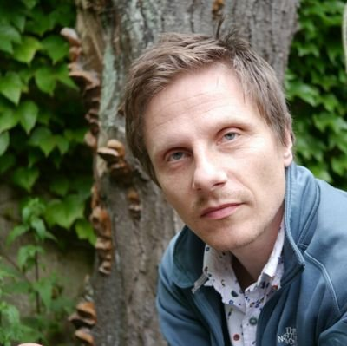

Instructors
Lectures: Grzegorz Chrupała
  Computational linguistics, applied machine learning
  http://grzegorz.chrupala.me
Practicals: Chris Emmery
  Social network mining
  https://cmry.github.io

Slide 3
Practical Matters

Slide 4
Lectures
Attendance is expected
Slides are not meant to be self-contained
  Take notes!

Slide 5
Course forum
Subscribe to the course forum on BlackBoard
Ask any question regarding course content and organization
Try to answer fellow students' questions
Chris and me will be monitoring the forum

Slide 6
Assessment
Final exam
In-class tests

Slide 7
SDM ML
Beginner: no prerequisites
Broader
Less technical detail
Practicals with Orange
Programming in Python
More focused
More technical detail
Practicals with Python
Overlap in content
Don't try to follow both at the same time

Slide 8
What is Data Mining
“Data mining is the computational process of discovering patterns in large data sets involving methods at the intersection of artificial intelligence, machine learning, statistics, and database systems.”
https://en.wikipedia.org/wiki/Data_mining

Slide 9
Related Fields
Statistics
  branch of mathematics focused on data
Machine Learning
  branch of Computer Science studying learning from data
Artificial Intelligence
  Interdisciplinary field aiming to develop intelligent machines

Slide 10
Key aspects
Computation
Large data sets
Computation enables analysis of large data sets

Slide 11
How large is large?
Too big for manual analysis
Too big to fit in RAM
Too big to store on disk
...

Slide 12
Supervised learning
Unsupervised learning
Regression
Dimensionality reduction
Classification
Clustering
Structured prediction
Topic modeling
Anomaly
detection

Slide 13
Supervised learning
Input
Output

Slide 14

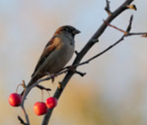
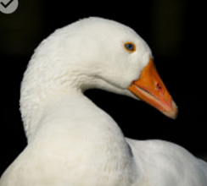
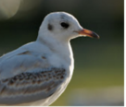
Classification
Black headed Gull
House Sparrow
Greylag Goose
?

Slide 15


Regression
24
3
32
?

Slide 16
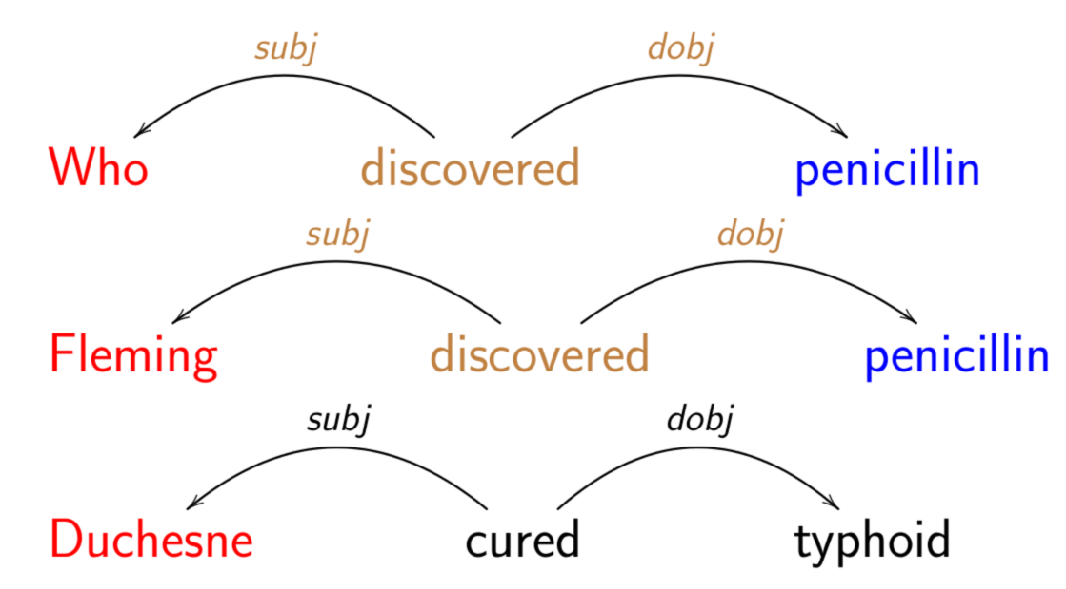
Structured prediction
Who discovered penicillin
Fleming discovered penicillin
Duchesne cured typhoid
Penicillin kills bacteria
?

Slide 17

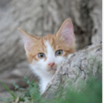
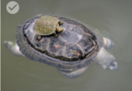
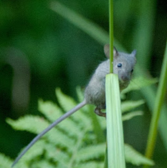

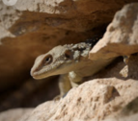
Clustering

Slide 18
Clustering

Slide 19

Anomaly detection

Slide 20
Anomaly detection

Slide 21
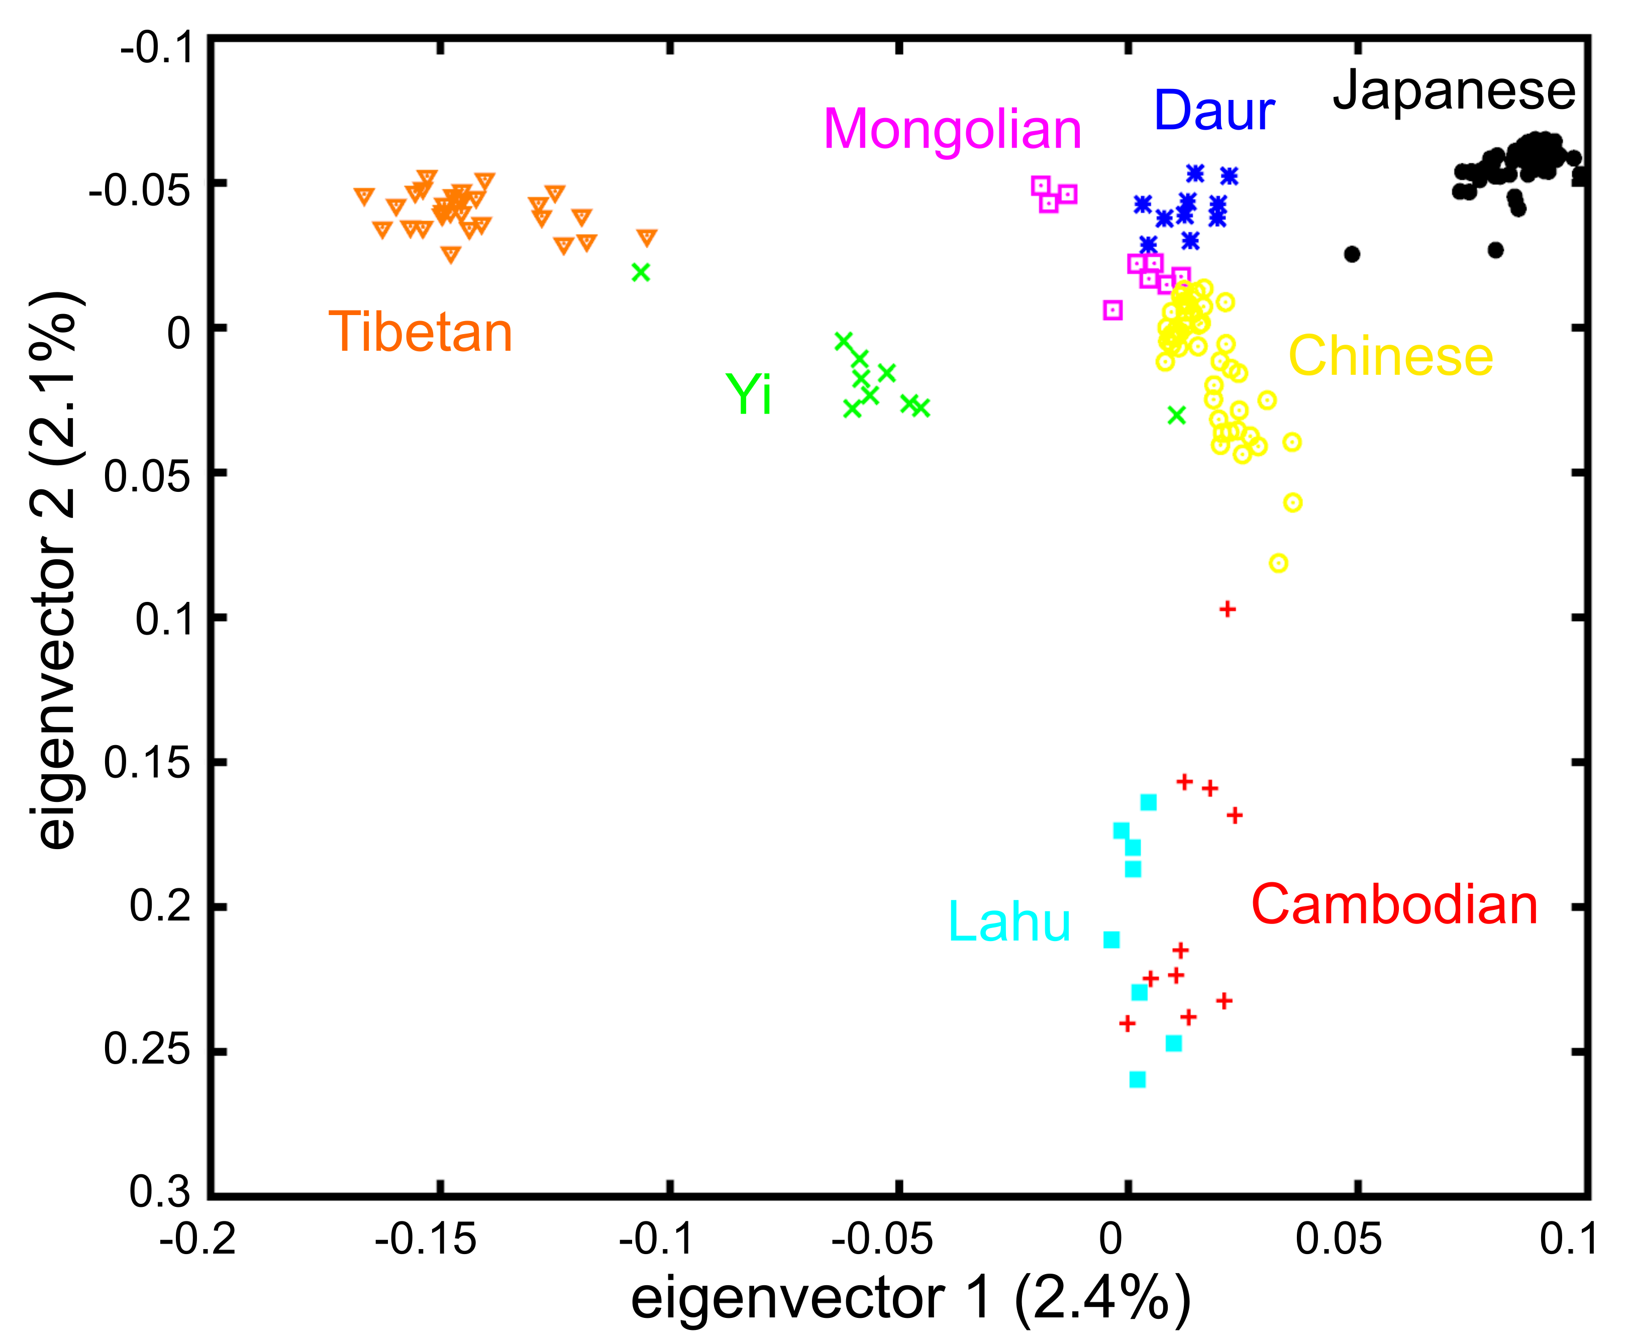
Dimensionality reduction
By Binbin Wang , Yong-Biao Zhang , Feng Zhang, Hongbin Lin, Xumin Wang, Ning Wan, Zhenqing Ye, Haiyu Weng, Lili Zhang, Xin Li, Jiangwei Yan, Panpan Wang, Tingting Wu, Longfei Cheng, Jing Wang, Duen-Mei Wang , Xu Ma , Jun Yu [CC BY 2.5 (http://creativecommons.org/licenses/by/2.5)], via Wikimedia Commons

Slide 22
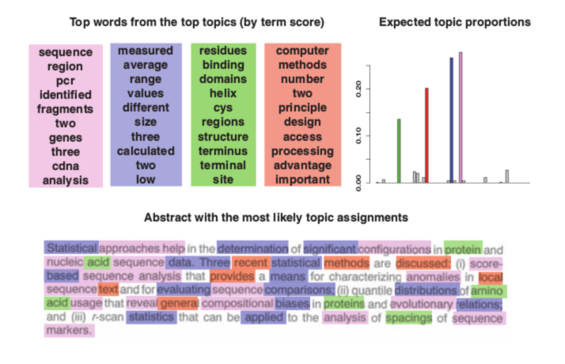
Topic modeling
Blei, D. M., & Lafferty, J. D. (2009). Topic models. Text mining: classification, clustering, and applications, 10(71), 34. http://citeseerx.ist.psu.edu/viewdoc/download?doi=10.1.1.463.1205&rep=rep1&type=pdf#page=96

Slide 23
Supervised learning
Workflow
Collect data
Label examples
Choose example representation
Train model(s)
Evaluate

Slide 24
1. Collect data
How do you select your sample?
Reliability of measurement
Privacy and other regulations

Slide 25
2. Label examples
Annotation guidelines
Measure inter-annotator agreement
Crowdsourcing?

Slide 26
3. Representation
Features – attributes describing examples
  Numerical
  Categorical
Possibly convert to feature vectors

Slide 27
Feature vectors
A vector is a fixed-size list of numbers
Some learning algorithms require examples represented as vectors

Slide 28
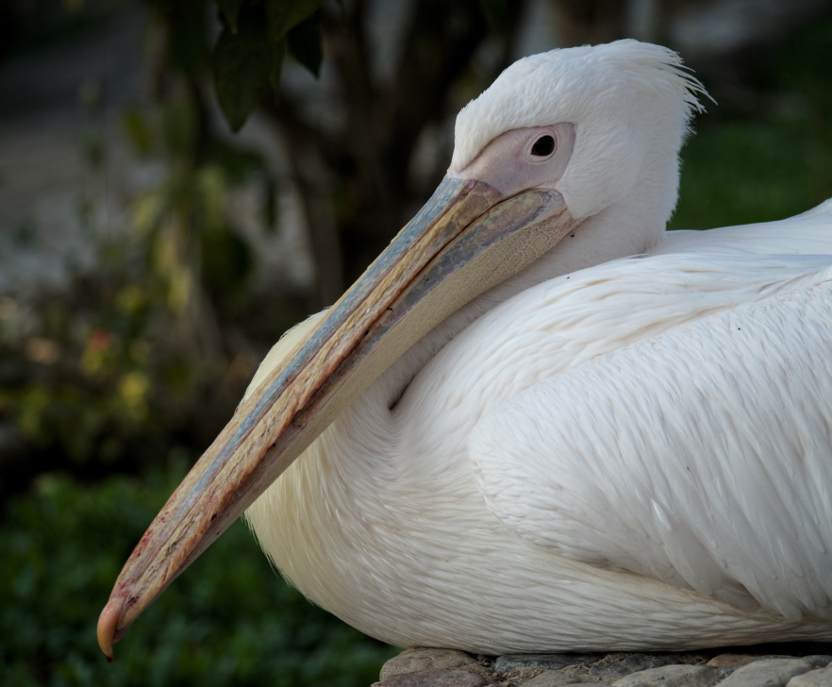
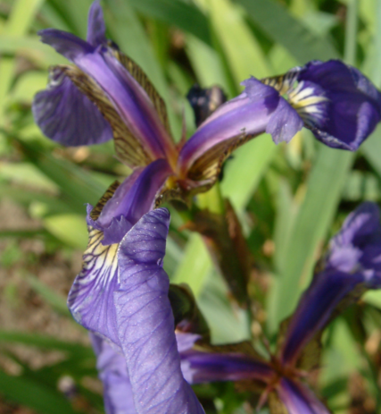
Sepal.Length Sepal.Width Petal.Length Petal.Width
5.1 3.5 1.4 0.2

Slide 29
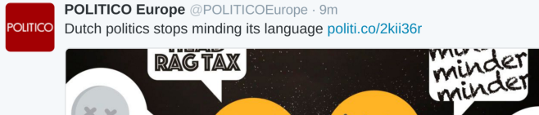
aardvark Danish Dutch it its lamb language minding politics stays stops …
0 0 1 0 1 0 1 1 1 0 1

Slide 30
4. Train
Keep some examples for final evaluation: test set
Use the rest for
  Learning: training set
  Tuning: validation set

Slide 31
Tuning
Learning algorithms can have settings (aka hyperparameters)
For each value of hyperparam:
  Apply algo to training set to learn
  Check performance on validation set
Choose best-performing setting

Slide 32
5. Evaluate
Check performance of tuned model on test set
Goal: estimate how well your model will do in the real world.
Keep evaluation realistic.

Slide 33
Learning to predict
What makes prediction possible?
Associations between features
  Numerical: correlation coefficient
  Categorical: mutual entropy
Value of x₁ contains information about value of x₂

Slide 34
Iris
Sepal.Length Sepal.Width Petal.Length Petal.Width Species
94 6.0 2.9 4.5 1.5 versicolor
95 5.4 3.0 4.5 1.5 versicolor
96 6.7 3.1 4.7 1.5 versicolor
97 6.0 2.2 5.0 1.5 virginica
98 6.3 2.8 5.1 1.5 virginica
99 6.3 3.3 4.7 1.6 versicolor

Slide 35
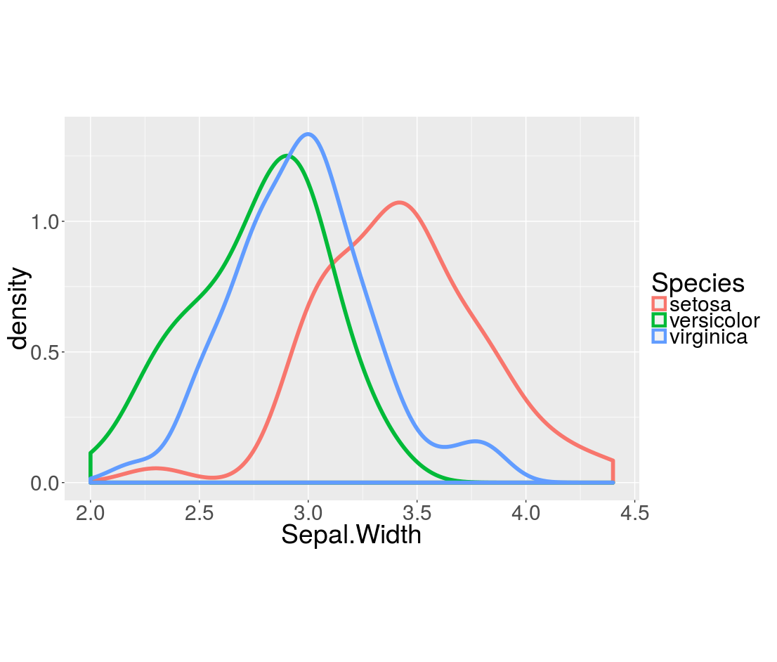
Iris: Sepal Width vs Species

Slide 36
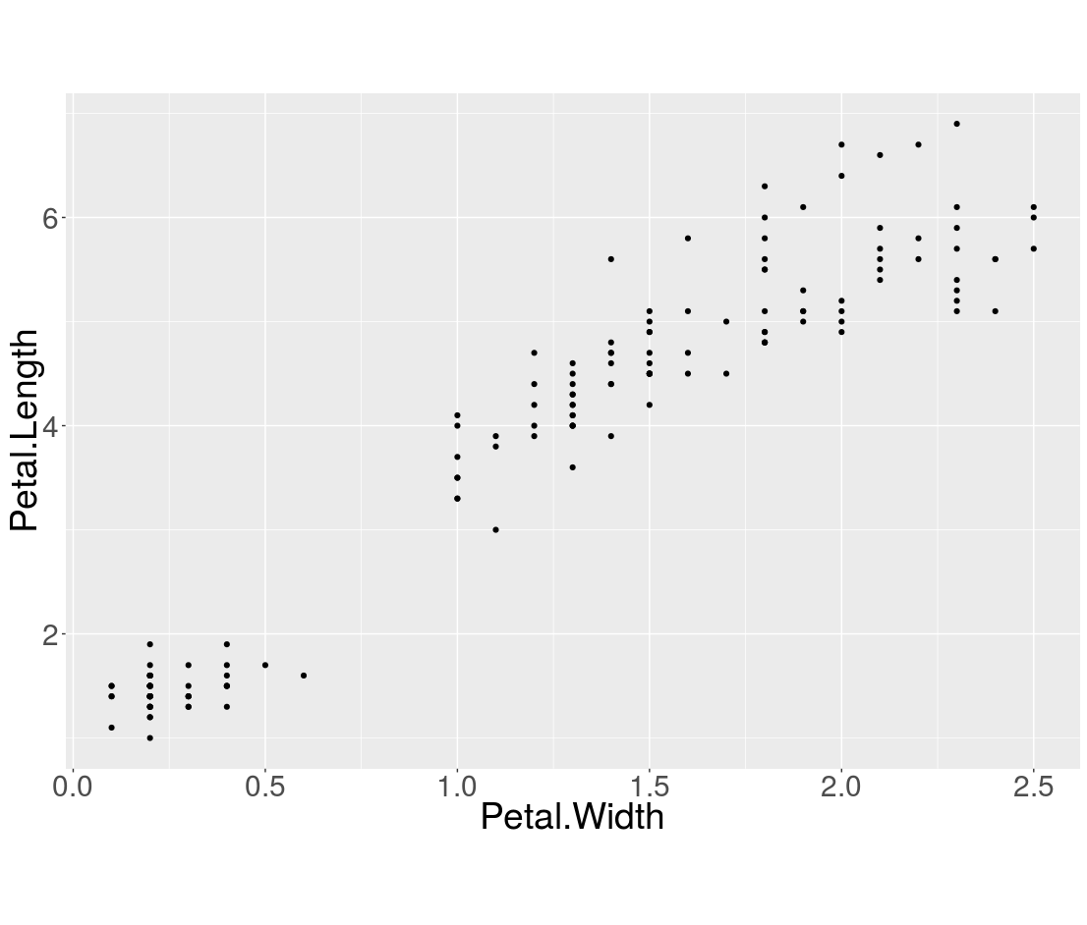
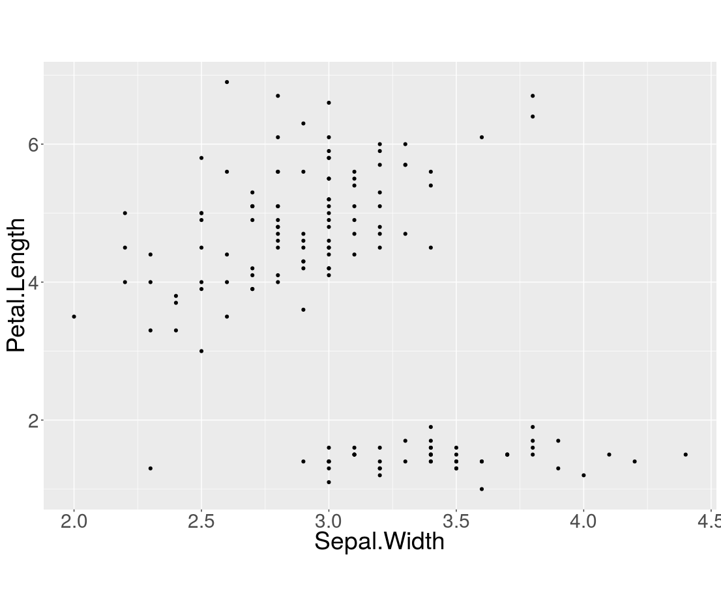
Iris: Petal Length

Slide 37
Pearson's correlation coefficient
Numerator: covariance. To what extent the features change together.
Denominator: product of standard deviations. Makes correlations independent of units.

Slide 38
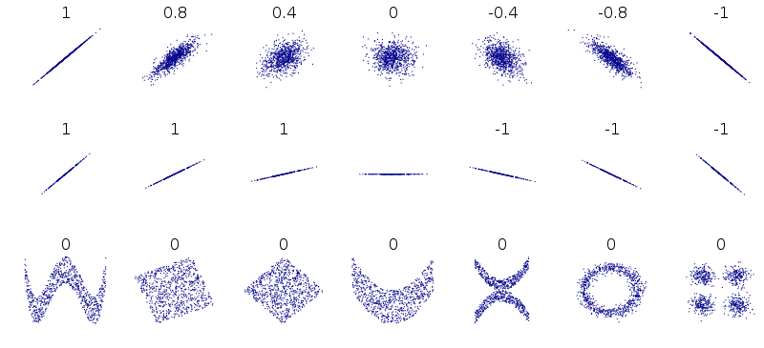
Caveats
Pearson's r only measures linear dependency
  Other types of dependency can also be used for prediction!
Correlation does not imply causation
  but it may still enable prediction

